Slide 1
Rapid Web App Dev in Spring Boot
Maciej Garbacz

Slide 2
Table of contents:
What and why of Spring Boot
Spring Initializr + REST API = Hello World
A Time-logging application (JDBC, Spring Profiles, H2 DB)
Future of Spring Boot and conclusions

Slide 3
Code available at:
https://github.com/MacGarbacz/workshop.git

Slide 4
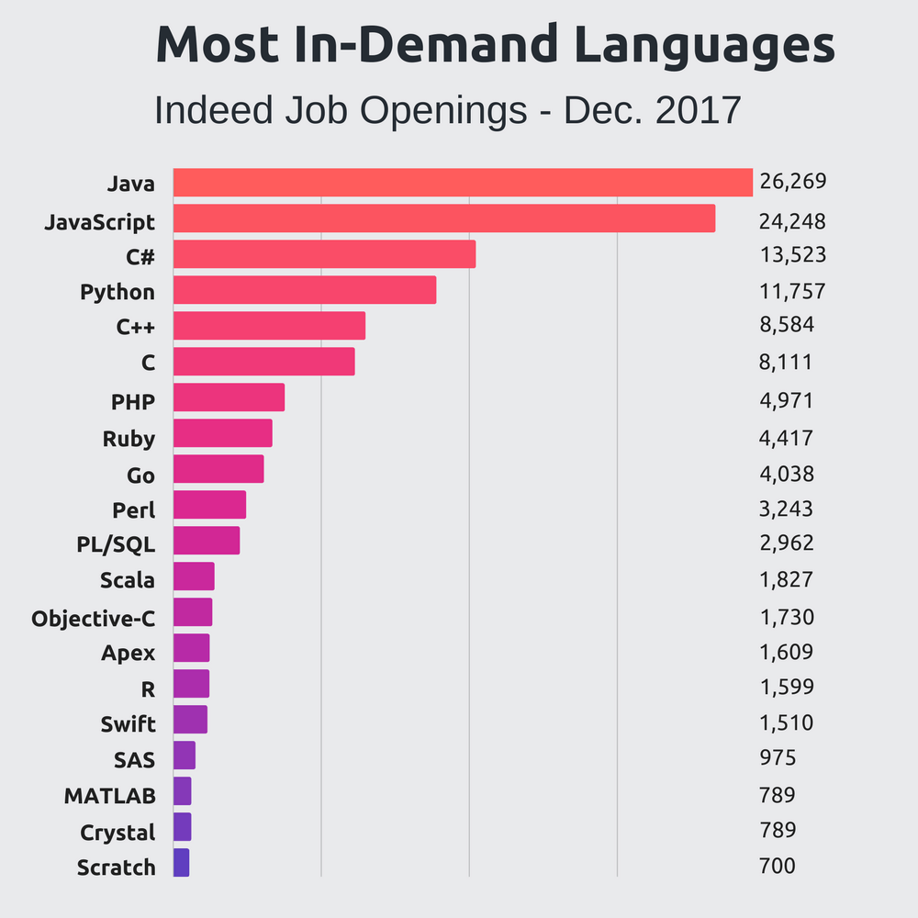
What is Spring?
Framework for enterprise grade Java applications
Inversion of control (IoC) container
Original release - 2002
Image source: https://stackify.com/popular-programming-languages-2018/

Slide 5
What is Spring Boot and why use it?
Spring Boot makes it easy to create stand-alone, production-grade Spring based Applications that you can "just run".[1]
Enables creation of stand alone applications
Features an embedded Tomcat
No initial configuration/XML required
Convention over configuration

Slide 6
Demo 1

Slide 7
Demo 2

Slide 8
Future and conclusions

Slide 9
Questions?

